Slide 1
Statistical Learning Revisit

Slide 2
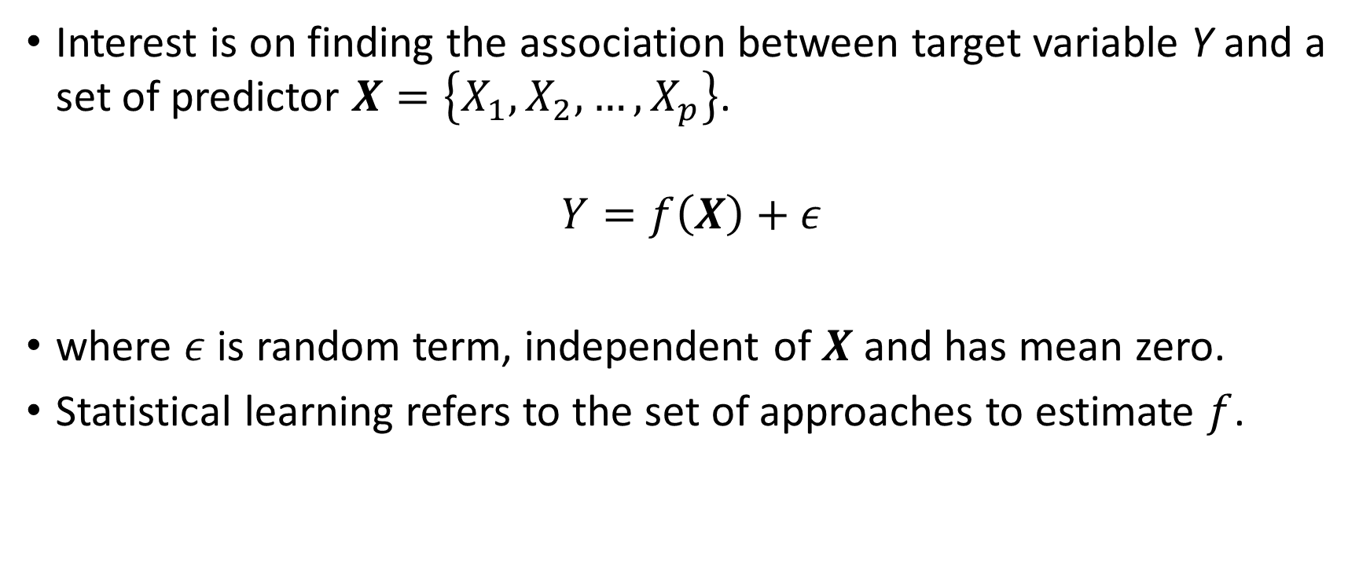
Recap: Statistical learning
Interest is on finding the association between target variable Y and a set of predictor $X=\left\{X_{1},X_{2},…, X_{p}\right\}$.
$$Y=f\left(X\right)+ε$$
where $ε$ is random term, independent of $X$and has mean zero.
Statistical learning refers to the set of approaches to estimate $f$.

Slide 3
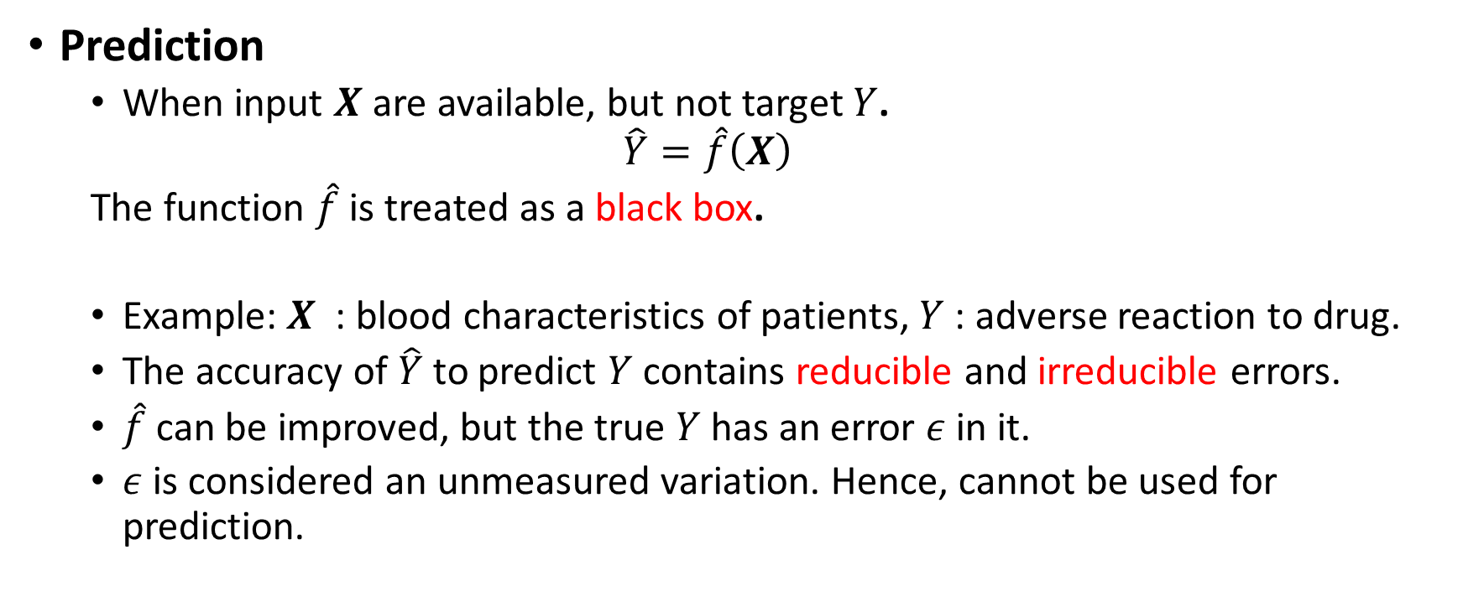
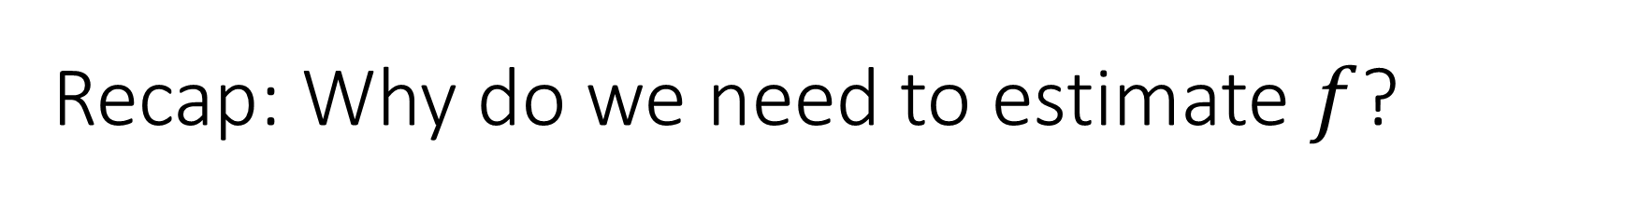
Recap: Why do we need to estimate $f$?
Prediction
When input $X$ are available, but not target $Y$.
$$\hat{Y}=\hat{f}\left(X\right)$$
The function $\hat{f}$ is treated as a black box.
Example: $X$ : blood characteristics of patients, $Y$ : adverse reaction to drug.
The accuracy of $\hat{Y}$ to predict $Y$contains reducible and irreducible errors.
$\hat{f}$ can be improved, but the true $Y$ has an error $ε$ in it.
$ε$ is considered an unmeasured variation. Hence, cannot be used for prediction.

Slide 4
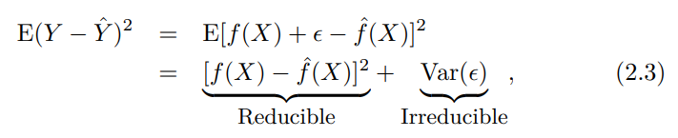
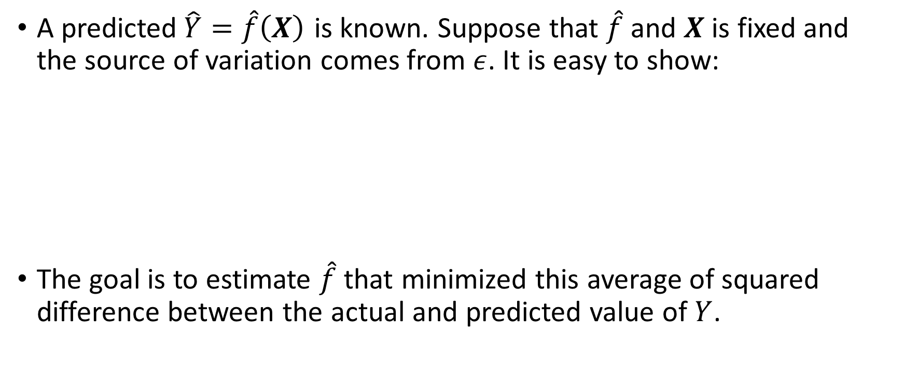
A predicted$\hat{Y}=\hat{f}\left(X\right)$ is known. Suppose that $\hat{f}$ and $X$ is fixed and the source of variation comes from $ε$. It is easy to show:
The goal is to estimate $\hat{f}$ that minimized this average of squared difference between the actual and predicted value of $Y$.

Slide 5
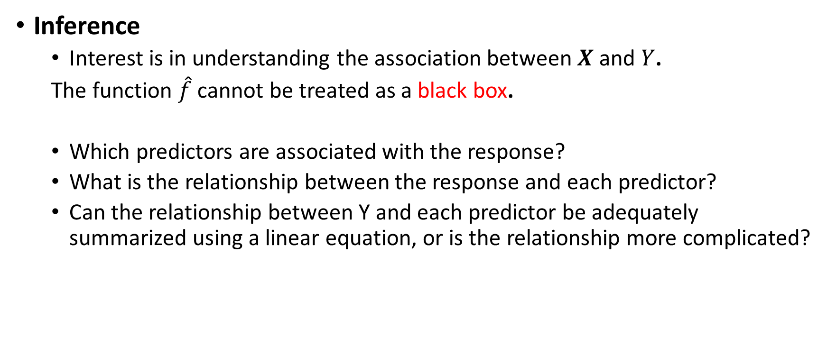
Recap: Why do we need to estimate $f$?
Inference
Interest is in understanding the association between $X$ and $Y$.
The function $\hat{f}$ cannot be treated as a black box.
Which predictors are associated with the response?
What is the relationship between the response and each predictor?
Can the relationship between Y and each predictor be adequately summarized using a linear equation, or is the relationship more complicated?

Slide 6
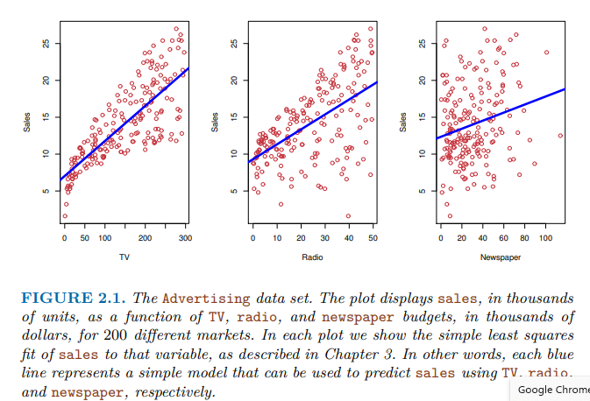
Prediction or Inference?
Depend on research questions.
Direct marketing campaign using set of demographic characteristics to determine whether individuals respond negatively or positively

Slide 7
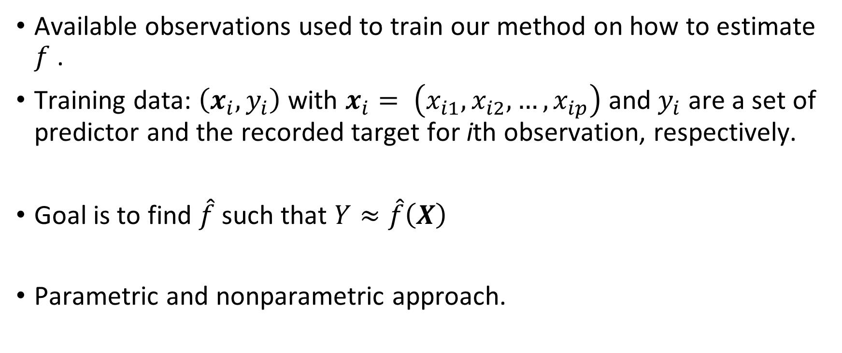
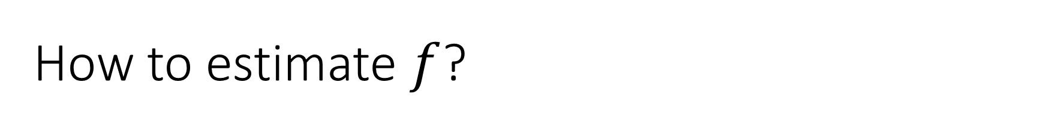
How to estimate $f$?
Available observations used to train our method on how to estimate $f$ .
Training data: $\left(x_{i},y_{i}\right)$with $x_{i}= \left(x_{i1},x_{i2},…,x_{ip}\right)$ and $y_{i}$ are a set of predictor and the recorded target for ith observation, respectively.
Goal is to find $\hat{f}$such that $Y≈\hat{f}\left(X\right)$
Parametric and nonparametric approach.

Slide 8
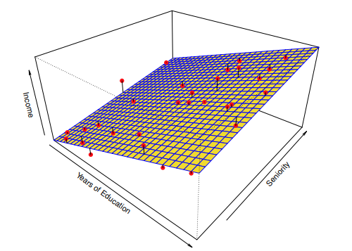
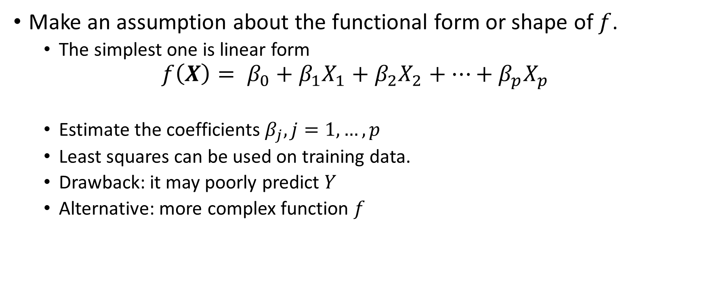
Parametric Approach
Make an assumption about the functional form or shape of $f$.
The simplest one is linear form
$$f\left(X\right)= β_{0}+β_{1}X_{1}+β_{2}X_{2}+…+β_{p}X_{p}$$
Estimate the coefficients $β_{j},j=1,…,p$
Least squares can be used on training data.
Drawback: it may poorly predict $Y$
Alternative: more complex function $f$

Slide 9
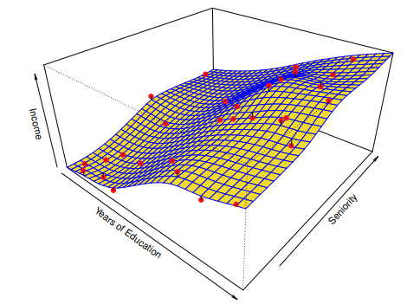
Nonparametric approach
It fits the training data by following the noise more in the training data.
What happen when we predict an observation that doesn’t belong to the training data?

Slide 10
Which one to choose?
Linear model vs more flexible model?
Trade – off between flexibility and interpretability
Supervised and unsupervised learning
Supervised: linear and logistics regression, GAM, boosting, support vector machine
Unsupervised: cluster analysis.
Regression and classification

Slide 12
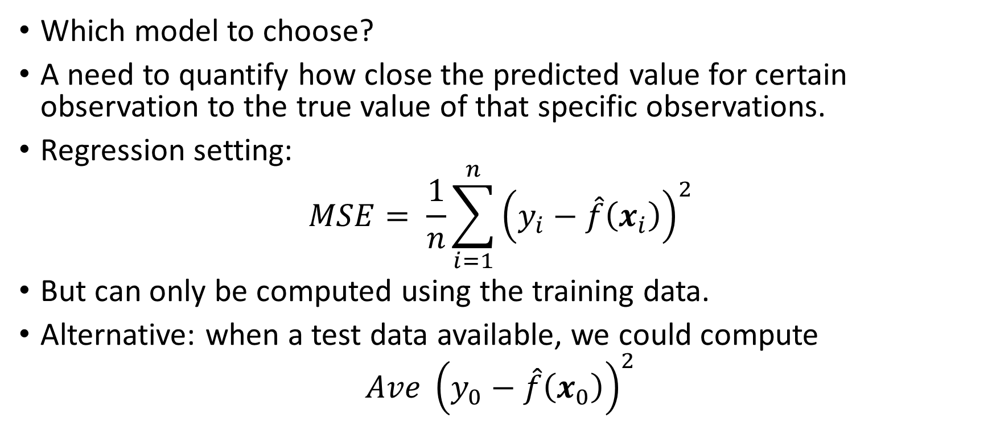
Assessing the model accuracy
Which model to choose?
A need to quantify how close the predicted value for certain observation to the true value of that specific observations.
Regression setting:
$$MSE= \frac{1}{n}\sum_{i=1}^{n}{{\left(y_{i}−\hat{f}\left(x_{i}\right)\right)}^{2}}$$
But can only be computed using the training data.
Alternative: when a test data available, we could compute
$$Ave {\left(y_{0}−\hat{f}\left(x_{0}\right)\right)}^{2}$$

Slide 13
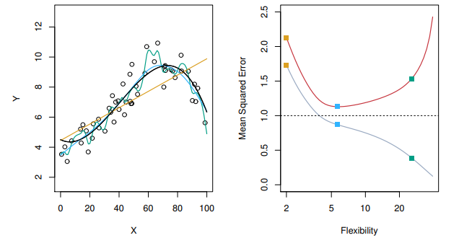
When no test data available
Use training MSE as it tends to be closer to test MSE, but not always.

Slide 14
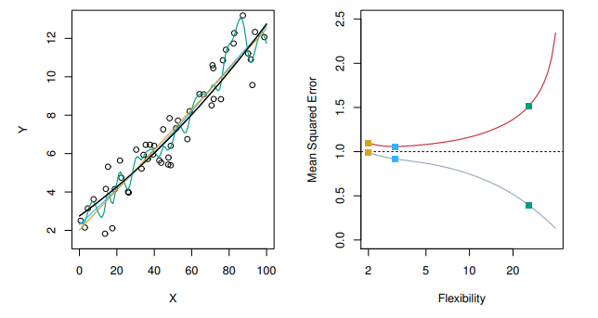
True data were smooth

Slide 15
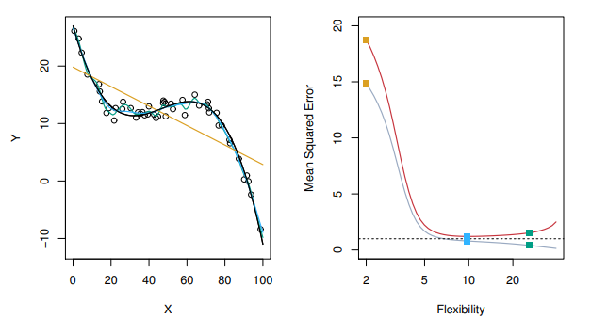
True data were wiggly

Slide 16
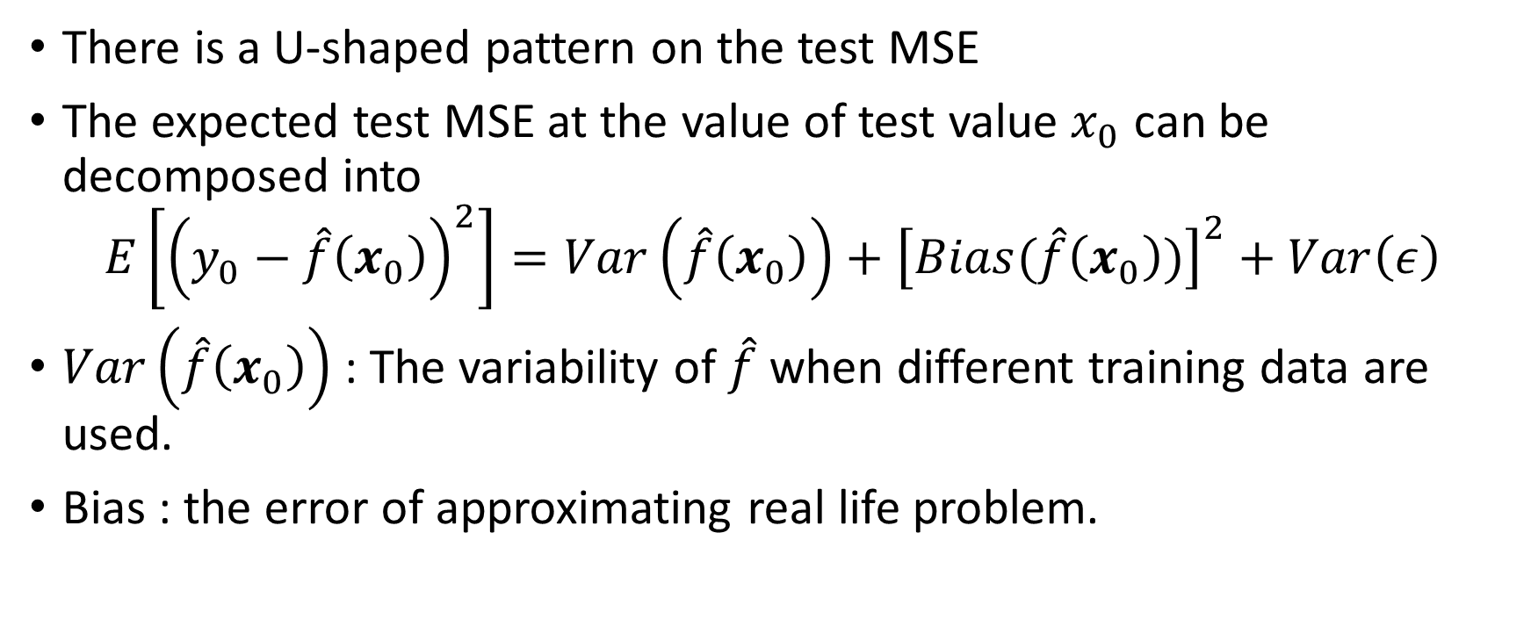
The bias-variance trade-off
There is a U-shaped pattern on the test MSE
The expected test MSE at the value of test value $x_{0}$ can be decomposed into
$$E\left[{\left(y_{0}−\hat{f}\left(x_{0}\right)\right)}^{2}\right]=Var\left(\hat{f}\left(x_{0}\right)\right)+{\left[Bias(\hat{f}\left(x_{0}\right))\right]}^{2}+Var\left(ε\right)$$
$Var\left(\hat{f}\left(x_{0}\right)\right)$ : The variability of $\hat{f}$ when different training data are used.
Bias : the error of approximating real life problem.

Slide 17
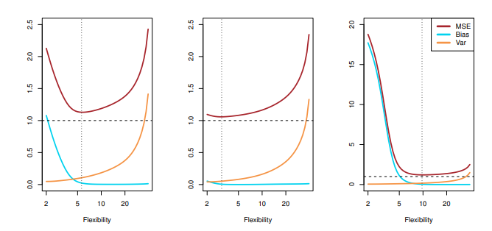

Slide 18
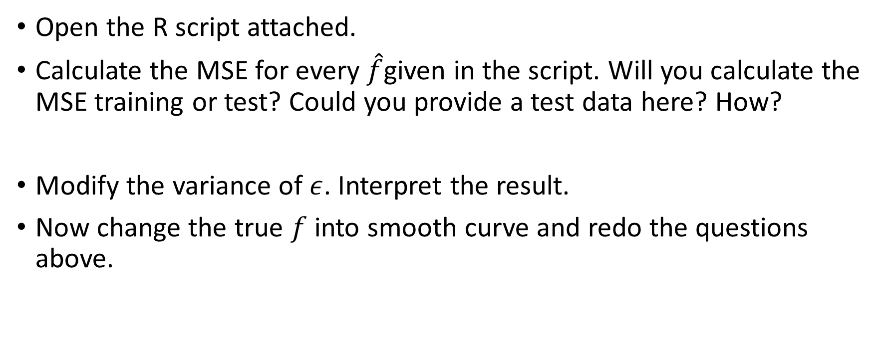
R Session.
Open the R script attached.
Calculate the MSE for every $\hat{f}$given in the script. Will you calculate the MSE training or test? Could you provide a test data here? How?
Modify the variance of $ε$. Interpret the result.
Now change the true $f$ into smooth curve and redo the questions above.

Slide 19
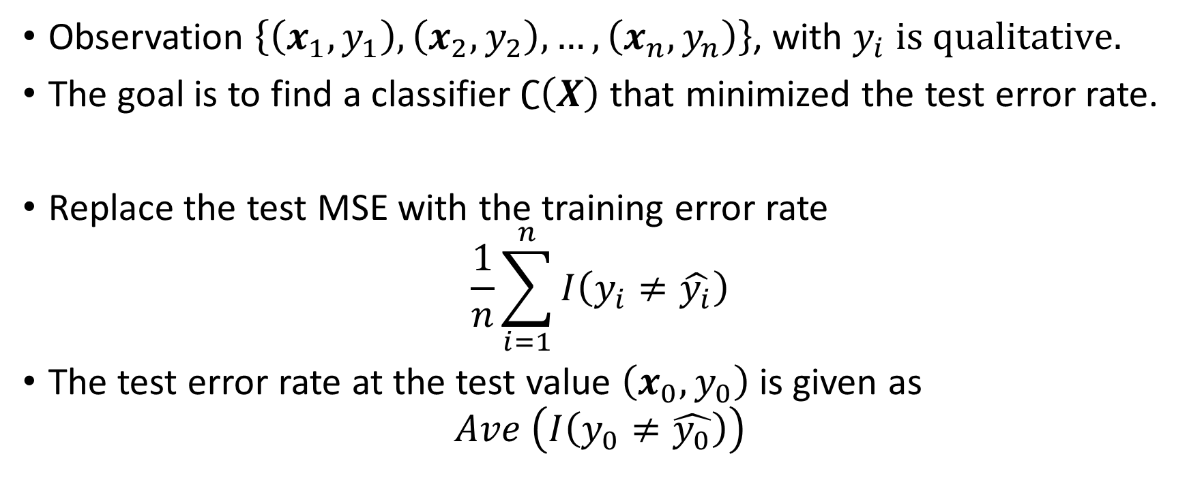
The classification setting
Observation $\left\{\left(x_{1},y_{1}\right),\left(x_{2},y_{2}\right),…,\left(x_{n},y_{n}\right)\right\}$, with $y_{i} is qualitative.$
The goal is to find a classifier $∁\left(X\right)$ that minimized the test error rate.
Replace the test MSE with the training error rate
$$\frac{1}{n}\sum_{i=1}^{n}{I\left(y_{i}≠\hat{y_{i}}\right)}$$
The test error rate at the test value $\left(x_{0},y_{0}\right)$ is given as
$$Ave \left(I\left(y_{0}≠\hat{y_{0}}\right)\right)$$

Slide 20
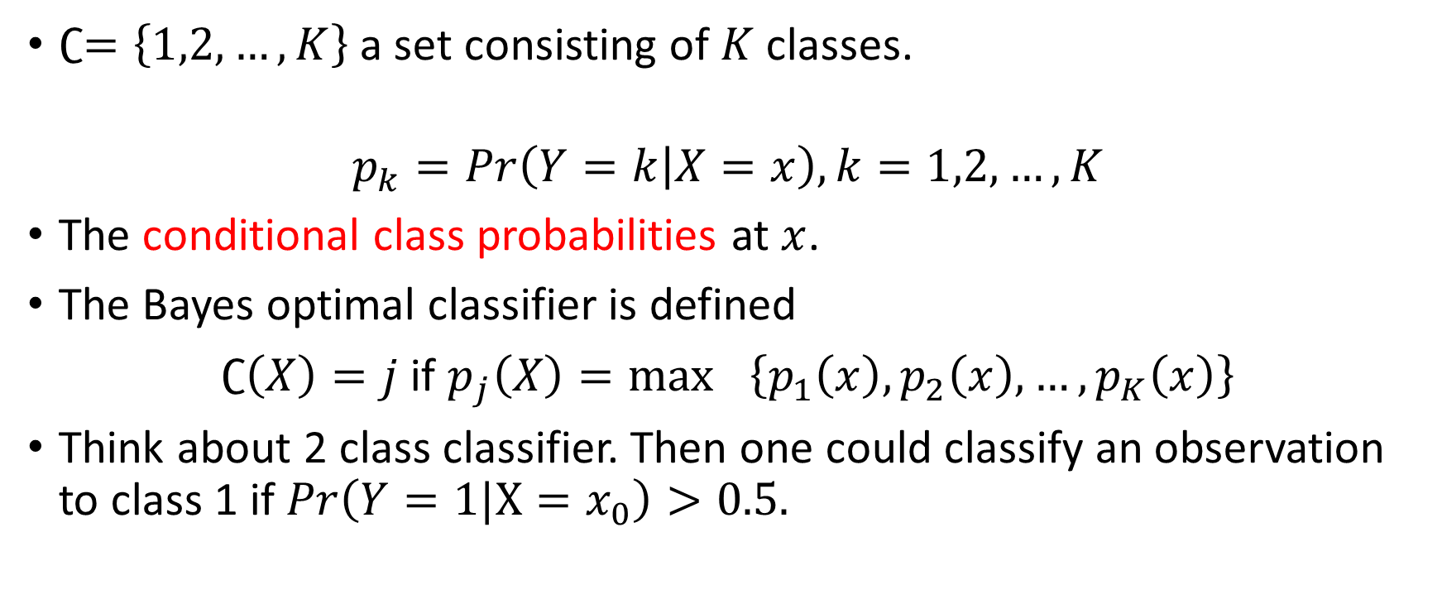
The optimal classifier?
$∁=\left\{1,2,…,K\right\}$ a set consisting of $K$ classes.
$$p_{k}=Pr\left(Y=k\left|X=x\right.\right), k=1,2,…,K$$
The conditional class probabilities at $x$.
The Bayes optimal classifier is defined
$∁\left(X\right)=j$ if $p_{j}\left(X\right)=\max_{}\left\{p_{1}\left(x\right),p_{2}\left(x\right),…,p_{K}\left(x\right)\right\}$
Think about 2 class classifier. Then one could classify an observation to class 1 if $Pr\left(Y=1|X=x_{0}\right)>0.5.$

Slide 21
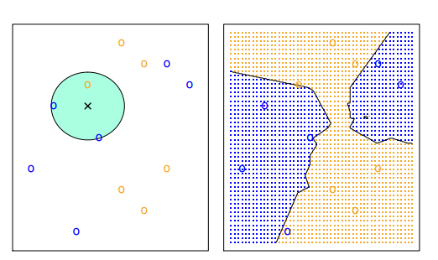

K-nearest neighbour
Distributional form of $Pr\left(Y=k\left|X=x\right.\right)$ is not always known. Alternatively one could choose K-nearest neighbor as a guidance to classify observations.

Slide 22
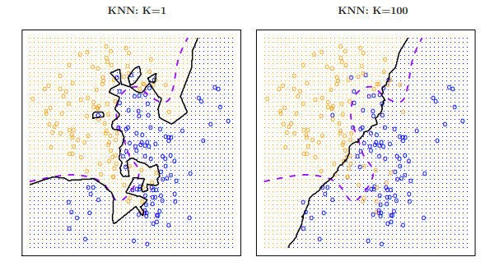
KNN depends on the tuning parameter k

